Slide 1
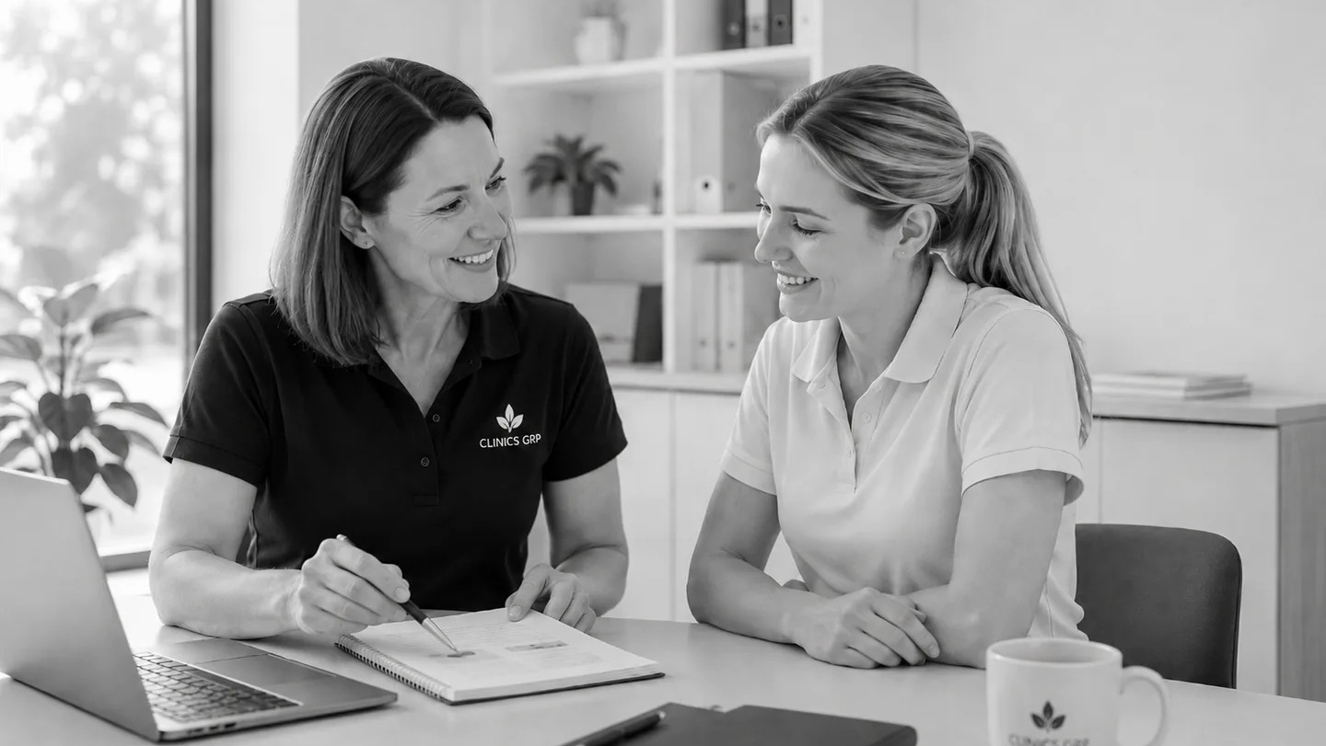


The Graduate
We Want to Hire
What to show in your GPY1 interview
A Clinics GRP hiring guide
CLINICS GRP GPY1 INTERVIEW GUIDE • 9 SLIDES
Notes:
Welcome. This guide explains what Clinics GRP needs to see in a Graduate Program Year 1 interview. You are not expected to know everything. You are expected to make your safety, growth and team contribution visible through specific examples.
[Sources]
- Clinics GRP graduate program webpage
- Clinics GRP GPY1 Graduate Program Flyer 2027

Slide 2

THE HIRING DECISION
Every strong interview answer proves one of three things
Your examples should make safety, growth and team contribution visible.
01
02
03
SAFETY
GROWTH
TEAM
Can we trust your judgement?
Can you learn quickly?
Can people rely on you?
Name the risk. Explain your reasoning. Say when you would seek help.
Describe feedback, reflection and the change it created.
Show clear communication, follow-through and contribution.
CLINICS GRP / GPY1 INTERVIEW GUIDE
02
Notes:
Across the interview, we are listening for three signals. First, can we trust your judgement and your willingness to escalate? Second, can you learn from feedback? Third, can patients and colleagues rely on you? A strong answer makes at least one of these signals obvious.
[Sources]
- User-provided source deck
- Clinics GRP graduate program webpage

Slide 3
WHAT THE INTERVIEW TESTS
We can teach systems.
You need to show professional judgement.
WE CAN TEACH
YOU NEED TO DEMONSTRATE
Our systems and documentation
Service-specific pathways
Caseload rhythm and specialist knowledge
Safety • Integrity • Reliability
Communication • Reasoning
Coachability • Ownership
“We hire for safe current capability and visible future trajectory.”
CLINICS GRP / GPY1 INTERVIEW GUIDE
03
Notes:
Clinics GRP does not expect a graduate to arrive knowing every workflow or specialist pathway. Those can be taught. The interview tests the professional behaviours underneath practice: integrity, reliability, communication, reasoning, coachability and ownership.
[Sources]
- User-provided source deck
- Clinics GRP GPY1 Graduate Program Flyer 2027

Slide 4
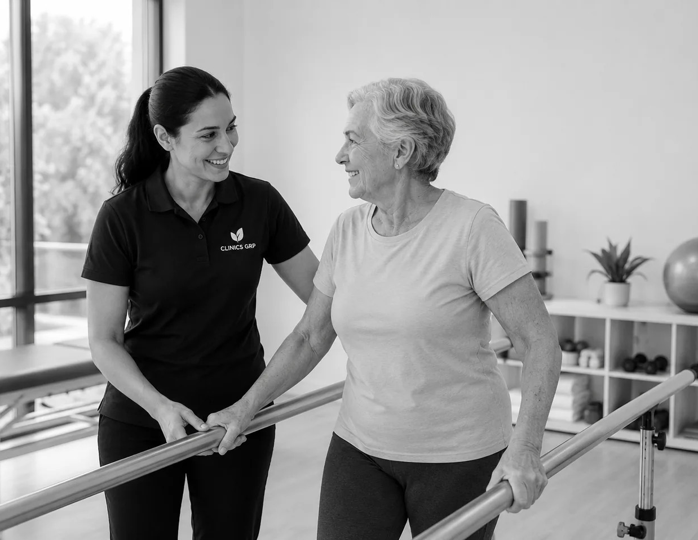
SAFETY
Show how you reason when the answer is not obvious
We do not expect certainty. We do expect safe judgement, transparency and timely escalation.
USE THIS ANSWER STRUCTURE
1
This was the situation and the risk.
2
This is what I noticed and considered.
3
This is where I was uncertain.
4
This is what I did—or would do—next.
A safe answer makes your limits and escalation pathway clear.
CLINICS GRP / GPY1 INTERVIEW GUIDE
04
Notes:
When you answer a safety question, do not jump straight to the outcome. Establish the situation and risk, explain what you noticed, name any uncertainty, and describe the next safe action. Speaking openly about limits increases confidence—it does not reduce it.
[Sources]
- User-provided source deck
- Clinics GRP graduate program webpage

Slide 5
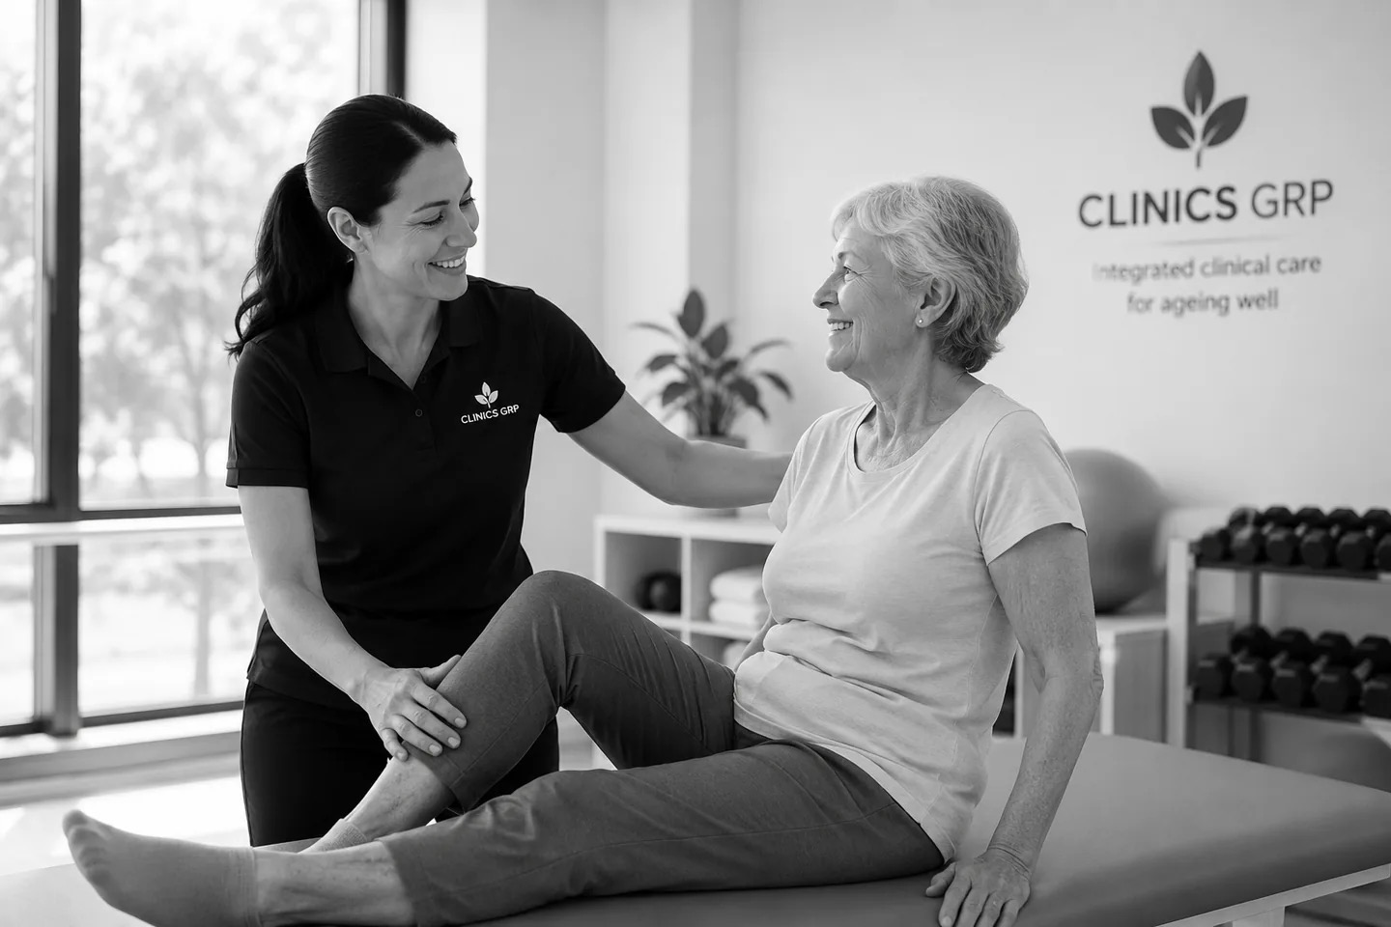
PERSON-CENTRED PRACTICE
Show that clinical decisions start with the person
A strong answer connects findings and risk to the person’s goals, preferences and context.
IN YOUR EXAMPLE, ANSWER
“What mattered to the person?”
Connect findings to function.
Explain the options you considered.
Show how you adapted for fear, fatigue, cognition or context.
CLINICS GRP / GPY1 INTERVIEW GUIDE
05
Notes:
A clinically correct answer is stronger when it shows what mattered to the person. Explain how the person’s goals, preferences, fear, fatigue, cognition or home context shaped your reasoning. That demonstrates person-centred practice rather than a generic treatment plan.
[Sources]
- User-provided source deck
- Clinics GRP graduate program webpage

Slide 6
GROWTH
Coachability is feedback made visible
The strongest candidate may not start ahead—but they can show how feedback changed their practice.
01
02
03
04
Receive
Reflect
Apply
Verify
Name the feedback clearly.
Explain what you understood.
Show what you changed at the next safe opportunity.
Describe the result and how you kept the change.
“Do not just say you welcome feedback. Bring an example that proves you used it.”
CLINICS GRP / GPY1 INTERVIEW GUIDE
06
Notes:
Coachability is not a personality claim. It is a sequence you can evidence: receive the feedback, reflect on what it means, apply it safely, and verify that the change was visible and sustained. Prepare one example that includes all four steps.
[Sources]
- User-provided source deck
- Clinics GRP GPY1 Graduate Program Flyer 2027

Slide 7
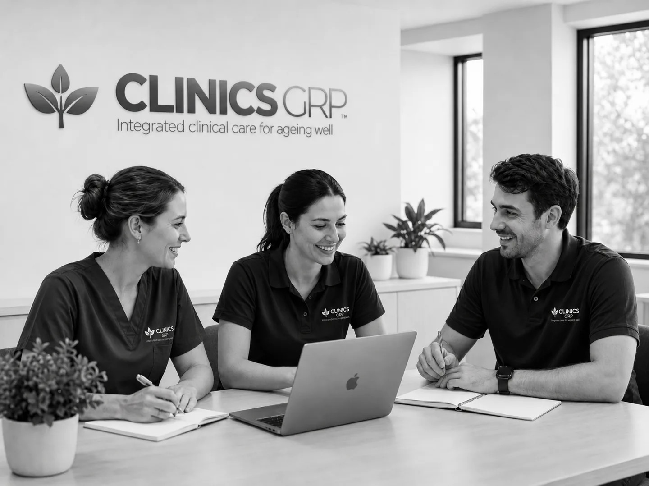
TEAM
Show how you make the team safer and stronger
We look for communication, follow-through and contribution—not performance in isolation.
COMMUNICATE
Listen first. Explain clearly.
Raise concerns early.
FOLLOW THROUGH
Prepare. Complete notes and handover.
Keep promises. Close the loop.
CONTRIBUTE
Stay engaged. Offer appropriate help.
Support the team’s work.
CLINICS GRP / GPY1 INTERVIEW GUIDE
07
Notes:
Teamwork is more than being friendly. We are listening for behaviours that make care safer: clear communication, early escalation, reliable follow-through and appropriate contribution. Choose an example where another person could depend on what you did.
[Sources]
- User-provided source deck
- Clinics GRP graduate program webpage

Slide 8
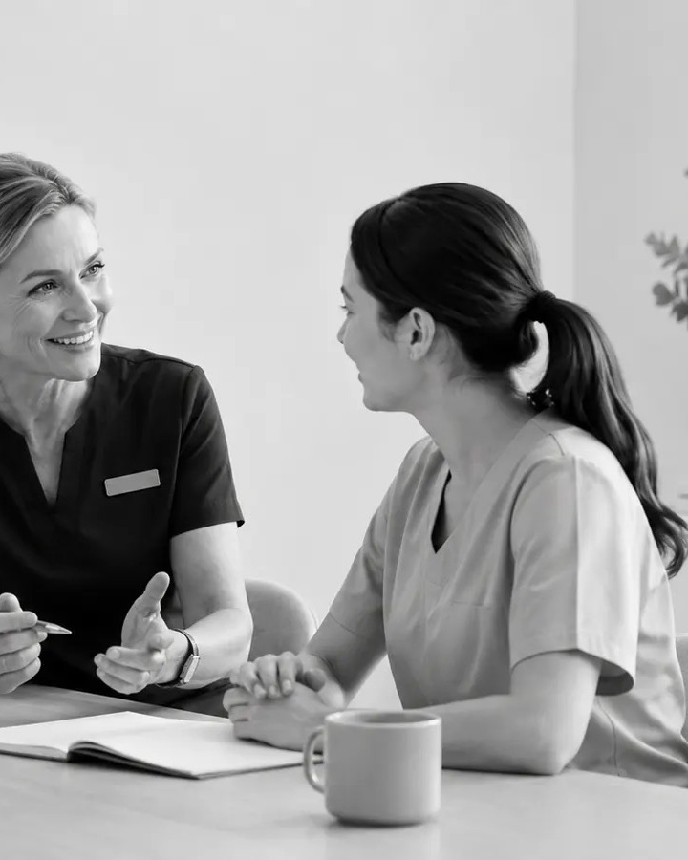
BEFORE THE INTERVIEW
Build an evidence bank—not a script
Prepare short examples you can adapt to different questions.
1
2
3
Safety
Growth
Team
A risk you recognised.
How you reasoned.
When you escalated.
Feedback you received.
What you changed.
What happened next.
How you communicated.
How you followed through.
How you contributed.
Add one person-centred story:
“What did the person need, and how did that change your approach?”
CLINICS GRP / GPY1 INTERVIEW GUIDE
08
Notes:
Before the interview, build a small evidence bank. Prepare one example for safety, one for growth and one for team contribution. Add a person-centred story. Do not memorise a script. Know the facts, your reasoning, what you learned and the result.
[Sources]
- User-provided source deck
- Clinics GRP graduate program webpage

Slide 9
WHAT MAKES US SAY YES
BRING EVIDENCE OF
We trust your judgement.
We can see you will grow.
You make the team better.
Safe reasoning.
Clear communication.
Coachability.
Person-centred care.
Reliable team contribution.
Be specific. Be reflective. Be honest about what you still need to learn.
CLINICS GRP / GPY1 INTERVIEW GUIDE
09
Notes:
The decision is not based on polish alone. We need to trust your judgement, see evidence that you will grow, and understand how you make the team better. Be specific, reflective and honest about what you still need to learn. That is the graduate we want to hire.
[Sources]
- User-provided source deck
- Clinics GRP GPY1 Graduate Program Flyer 2027

